Slide 1

AI MEDIA TRACKING PIXEL OVERVIEW
Ai Media Group
1359 Broadway 5th Floor
New York, NY 10018
(212) 660-2400
www.aimediagroup.com

Slide 2

Atrilyx MARKETING PIXEL KEY OBJECTIVE TO SUPPORT A CUSTOMER EXPERIENCE MODEL
Purchase
Discover
Use
Consider
Customers now expect their experiences to be continuous, constant, customized, cross-device and cross-channel.
Ai Media ad technology allows us to track, measure and optimize marketing campaigns and deliver a continuous customer experience with the Full Funnel Marketing and addressing new Privacy laws.
Promises
Delivery
Evaluate
Open Content and Channels
Branded Content and Channels

Slide 3


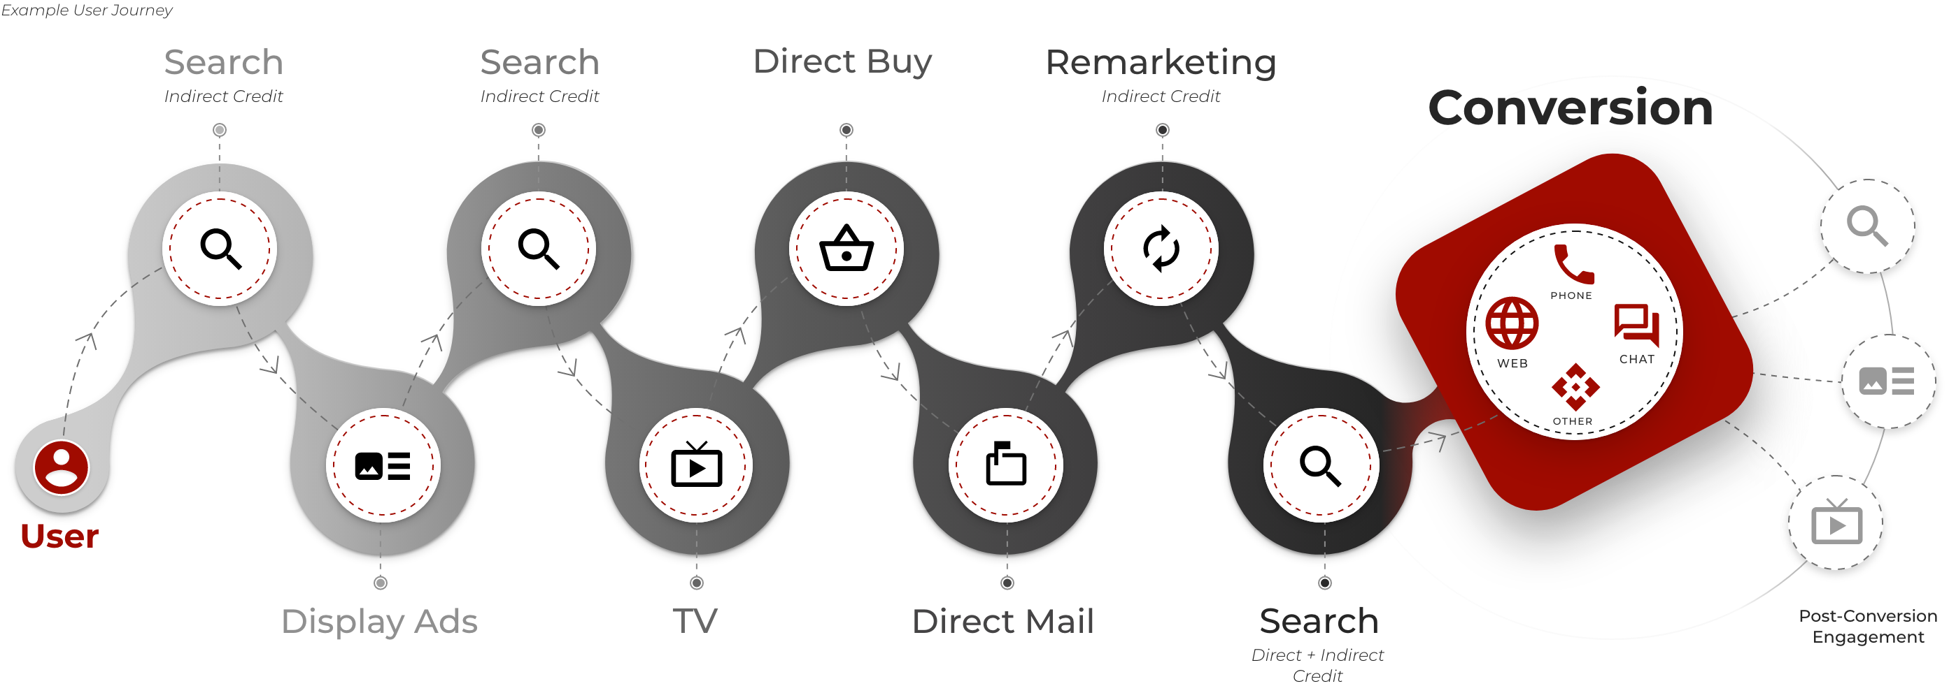
Atrilyx TRACKING PIXEL OVERVIEW
The Ai Media Marketing pixels, aka tracking pixels, is a code snippet of code we provide to the Client to place on their Tag Management Solution. For example: Google GTM, Adobe Launch (DTM) , Tealium, Signal, Enlighten etc.
Ai Media can also provide an Ai fully hosted tag management solution for complete control of all data streams.
If needed, we can hard code the pixel on the client site, but we do not recommend this. Leveraging the tag management solution or system (TMS) allows Ai Media to keep all the tags on your website inside of a single master set of code that fires on-page and in the buy flow to track and report on that path to conversion for advertising.
The Ai Media pixel is used to measure a marketing campaign’s performance, track conversions, and build an audience base by gathering information about visitors on a website from paid media. The pixels track browsing behavior, the type of ads they click on, if they abandon a page or the buy flow, take a purchase action, fill out a lead gen form, etc.
This behavior data helps Ai Media as a marketer to optimize the media spend to increase lead performance and sales and track attribution with our proprietary ad technology while adhering to all privacy and compliance laws, including CCPA GDPR.

Slide 4

You get all the capabilities of a Customer Data Platform without having to implement one leveraging Ai Ad Tech Tracking Pixel that abides with Privacy & Compliance laws.
Universal ID Tagging customers with a single ID that can then be used to reconcile spending, analytics, and attribution across channels.
Unifying User Identities Across Channels Deduplication, collation, and harmonization of customer profiles based on data collected across all channels, even when these identities include components of different types (e.g. device IDs, hashed emails, statistical IDs, micro-neighborhoods, and zip+4 etc.).
Data Ingestion & Export Our pre-existing library of APIs allow us to bring in data points from various network partners, systems of record and engagement and pass data back to systems of record to continually enhance the customer profile and optimize performance marketing efforts
Cleanliness and Accuracy of Data - Harmonization and collation of data across data streams
Audience Creation & Targeting Streamlining audience creation, segmentation and targeting across diverse sets of data points, and sending these to activation channels including TradeDesk, Facebook, Google 360 and Bing for users with selected segments.
Privacy Compliance All data collection, utilization, reporting, and segmentation is GDPR and CCPA compliant. Privacy compliance management across regulatory frameworks (e.g., GDPR/CCPA). providing unparalleled visibility into data governance and policy effectivity.

Slide 5

Use Case
How the Marketing Tracking Pixel allows Atrilyx to build audiences and effectively track, measure and optimize your campaigns and report on data inisghts.

Slide 6


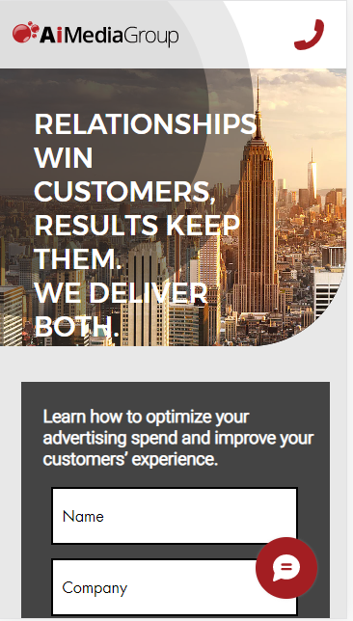
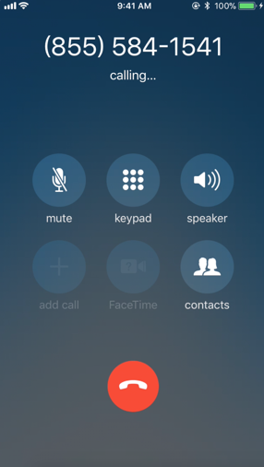




Run Higher-Performing Campaigns with Closed-Loop Attribution
AD
WEBSITE
PHONE CALL
Conversion
Non-conversion
REAL TIME
Adjust keyword Bids
Suppress Ads
Input for Smart Bidding Model

Slide 7







TRACKING THE END-TO-END CUSTOMER JOURNEY
TOUCHPOINTS & REPORTING ON CONVERSION DATA
GATHER DATA
CREATE AUDIENCE SEGMENTS
LOOK-A-LIKE /REMARKET
IMPRESSIONS, CLICKS, CTR’S and FORM COMPLETION
Form Completion
Create Look-a-Like Audience
Build unique audience profiles and identify most valuable segments and target them across multi-channels (Social, Display, Paid Search, Video)
Starts/Abandons/Completes a Lead Gen Form
Takes an Action
Atrilyx OID is passed into client’s Salesforce and mapped as
“Ai Media ID”
Lands on a Landing Page
Prospect Engages With an Ad
Online Ads Served
(Paid Search, Paid Social, GDN, YouTube)
1 to 1 Mapping
Ai Media uses Salesforce data to do Remarketing
Ai Media pulls client’s Salesforce Ai Media ID into Ai Analytics
Salesforce CRM data is used to enhance data insights reporting for audience segmentation targeting & remarketing

Slide 8
RETARGET PROSPECTS AND CUSTOMER THROUGH THE INTEGRATED CUSTOMER JOURNEY LEVERAGING TRACKING PIXEL DATA FIRED IN THE TAG MANAGEMENT.
MARKETING AUTOMATION USING TRACKING PIXEL FOR RETARGETING
Customer Journey
Leverage CRM Data for Acquisition / Retention
Inquiry
Prospects / Customer
Not everyone is ready to buy right away, so lead nurturing maintains an open line of communication until the prospect is ready to buy or customers are ready to upsell offers.
ENGAGE THE CONSUMER
Streamline lead nurturing capabilities to integrate with CRM data to have a 360 degree view of prospects and customers, to provide the right offer to the right person.
ENHANCE THE CUSTOMER EXPERIENCE
Suppress customers using CRM data with the LiveRamp data match partner to target prospects for acquisition sales and customers with cross-sell/upsell messaging.
Remarket based on Media Ad Engagement
Engaged Lead
Prospects / Customer
AWARENESS
Remarket based on Website Engagement
ENGAGEMENT
Qualified Lead
Prospects / Customer
CONSIDERATION
Remarket based on Offer Engagement
Conversion
Prospects / Customer
PURCHASE
Remarket based on Application
Abandonment Engagement
RETENTION
Retention
Customer / Cross-Sell
and Up-Sell
TRACK, Measure and Optimize Customer Journey across the funnel

Slide 9
PIXEL IMPLEMENTATION
The setup information is delivered to the tracking team. Required information is:
URL of website
URL of specific landing pages
Primary KPIs to track (forms, calls chat etc.)
Secondary KPIs to track (site interactions)
conversion window
The team is granted edit access to the GTM container that is installed on the client site
A GTM workspace template is imported into the GTM with all the base ai tags, variables and triggers
The tracking developer will then go and add in additional variables triggers and tags to track all the aforementioned KPIs as dictated in the setup
If the site is an e-commerce site, additional tracking is setup to track each and every step of the ecommerce funnel to measure what items are:
  product view
  added to the cart
  removals from cart
  begin checkouts
  purchases
If direct access cannot be granted to the Ai Tracking team, the tracking team will compile a tagging spreadsheet sending tags to track each of the above outlined steps. When a tagsheet is sent, the ai tracking team cannot setup variables or tag triggers. The Ai tracking team will provide the rule definitions for the tags to fire, but it is the responsibility of the clients internal tagging team to implement and QA the implementation

Slide 10
PIXEL TRACKING PROTOCOL
Pixel Tracking Protocols
  Ai Media Group’s pixel by default is an asynchronous JavaScript pixel
      This tag allows us track the user on your site and to set first party cookies to record visit and attribution data
      Same domain CNAMEs are available so all cookies set are 1st party same domain for ITP compliance.*
    Alternative image and iframe pixels are available, but tracking fidelity is reduced*
Security Protocols (HTTPS vs HTTP Pixel)
Many browsers like Chrome detect and label sites if they are unsecure. You can tell a site is secure if the URL begins with “https://” instead of “http://”. These browsers only load secure content from secure sites. HTTP iframe and image pixels are not secured content, so secure sites will block them as well.
Ai Media’s pixels are secure (https) and will work on all sites
Tracking tag types (JavaScript vs iframe vs Image Pixel)*
Pixel tracking protocols can use a JavaScript tag, an HTML iframe or image tag to collect user tracking data and to track conversion events. If your site can use a JavaScript pixel over an image or iframe pixel, then there is no reason to use an image or iframe pixel protocol.
Image & pixels are the legacy tracking protocol and are provided only to integrate with tracking systems that can’t support other attribution methods. Image pixels also have additional limitations like only being able to load a single partner conversion pixel and being unable to load partner iframe conversion pixels.
*HTTPS://WEBKIT.ORG/BLOG/9521/INTELLIGENT-TRACKING-PREVENTION-2-3/

Slide 11








Atrilyx Data Flow
Data processing
and attribution modeling
First Party Client Data
AiConnect
Click Logs
3
Your Site
Pixel Data
9
Atrilyx Frontend application
8
Atrilyx Database
Client Facing APIS
2
Pixel Server
and Click Tracking
4
Website Tracking and Analytics
+ call tracking
Key
1.
User is served an ad and they click on it
User is redirected to client website via our AiConnect pixel tracking platform
User Activity is tracked on the client website
Data is collected in our Ai Analytics Platform
Visitor Logs are passed through to our identity provider to give us an anonymous household ID
Ad Network Data is pulled into data warehouse via API or flat file
Data is collated into reporting tables
Web tracking data is matched to network reports for reporting and attribution modeling
Client facing web application with charts, report tables etc. surfaced the data to
the end user
7
Collated Reporting Tables
2.
3.
4.
Network reports
5.
and more
6.
1
6
Data Warehouse
Creating ID
Ad Click
7.
8.
Log Export View
9.
5
Identity Provider

Slide 12

Atrilyx
CALL TRACKING

Slide 13
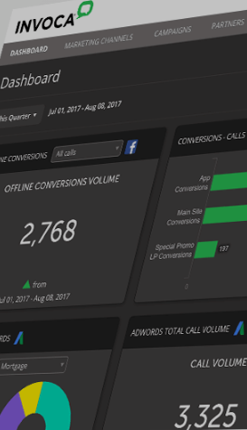
INVOCA PLATFORM OVERVIEW
Key Platform Capabilities:
Track inbound calls on a 1:1 consumer-level basis with dynamic number insertion for toll-free and local numbers
Capture customer journey data (e.g. campaign, search keyword, pageviews, etc.) with Invoca’s first-party JavaScript website tag
Integrate first- or third-party data to enhance the call record with additional offline information (e.g. CRM, demographic data)
Classify calls, detect conversions, and segment callers in real time with AI-powered predictive models and rules-based analytics, or import your own offline conversion data via file upload or API
Detect specific keywords spoken by caller or agent
Attribute call conversions in real-time and create targetable audiences by integrated call analytics into Google Ads, Facebook, Salesforce, Adobe Experience Cloud, Google Analytics, and more
Dynamically route calls based on data captured before the call (e.g., campaign, calling page, location, language, etc.) to connect caller to the right agent and reduce time spend in the IVR
Record calls and automatically redact sensitive information.
Notes:
Deployed entirely in the cloud, Invoca’s call tracking & analytics platform offers marketing teams the ability to measure the impact of marketing efforts on lead generation and sales from inbound phone calls. Invoca does this by capturing caller and campaign data on a 1:1 consumer level, and measuring and attributing calls and conversions to the marketing campaigns that drove them in real-time.

Slide 14
TAG MANAGEMENT SOLUTION OVERVIEW FOR CALL TRACKING
ENGAGE
UNIFY
ROUTE
ANALYZE
PUSH
Inbound calls on a 1:1 consumer basis
Digital and call data to into one profile
Callers dynamically
to the right place
using your online and offline data
Conversations in real-time to classify caller interests, intent, and conversions
Call outcomes and analytics to Ai Media ad tech stack

Slide 15

PHONE CALL -DATA PRIVACY & COMPLIANCE
Invoca maintains the following privacy and security certifications:
PCI DSS Certified Service Provider: Invoca systems have passed the most rigorous security requirements put forth by PCI DSS and is a certified Service Provider. Our Attestation of Compliance is available upon request.
SOC 2 Type 2 compliant: Invoca's service commitments and system requirements were evaluated and met the trust services criteria set by the AICPA. Report available upon request.
Trustwave PCI Merchant: Invoca is certified to accept credit card payments as a PCI certified merchant.
HIPAA compliance: Invoca provides the administrative, technical and physical safeguards to support your organization's compliance with HIPAA.
GDPR compliance: Invoca is compliant with The General Data Protection Regulation (GDPR) EU law
TRUSTe privacy certification: Invoca has obtained and continues to maintain privacy standards in compliance with the TRUSTe certification program.
Cloud Security Alliance STAR Certification: Invoca has completed and maintains a comprehensive Cloud Security Controls Matrix outlining our Information Security Program in detail.
Skyhigh Enterprise-Ready Cloud Provider: Invoca’s security controls have been evaluated against a strict set of security criteria developed by Skyhigh Networks
Notes:
Deployed entirely in the cloud, Invoca’s call tracking & analytics platform offers marketing teams the ability to measure the impact of marketing efforts on lead generation and sales from inbound phone calls. Invoca does this by capturing caller and campaign data on a 1:1 consumer level, and measuring and attributing calls and conversions to the marketing campaigns that drove them in real-time.

